Slide 1
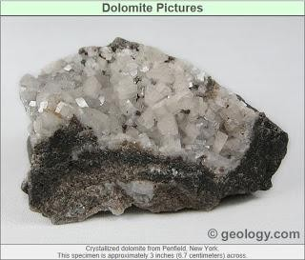
Ex.Lec 4 Extraction of Magnesium from ore oxide
Dr. Ahmed Ameed
Magnesium is the sixth most abundant element in the earth’s crust.
The main sources of magnesium compounds are:
Seawater (magnesium chloride, MgCl₂) and minerals:
Dolomite (CaCO₃•MgCO₃), contain 13%.
Magnesite (MgCO₃), contain 29%.
Brucite Mg(OH)2, contain 42%.
There are two principal magnesium extraction processes: silicothermic process and electrolytic process.
Silicothermic process (Pidgeon process)
The process involves reducing molten magnesium oxide slag by ferrosilicon under low gas pressure at a temperature of about 1400ºC.
The metallic magnesium, formed in the process, evaporates and then condensates away from the hot region.
The condensed magnesium, having purity of 99.95% is then remelt and cast. The Three Steps of the Pidgeon Process
Calcination of Dolomite, at 1300ºC, Highly Endothermic Reaction, CO₂ Released both from the reaction, and from Fuel Burned for Process Heat.
CaMg(CO₃)₂ CaO + MgO + 2CO₂
Ferrosilicon Alloy Production, the Ferrosilicon Alloy Production by Electric Arc through Mixture of Hematite, Quartz Sand, and Coal. Extremely Endothermic Reaction; Emits Toxic CO.

Slide 2
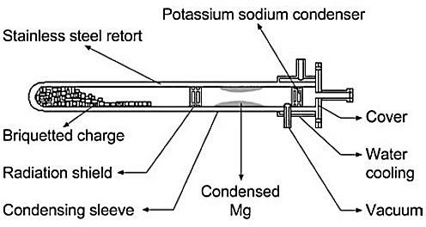
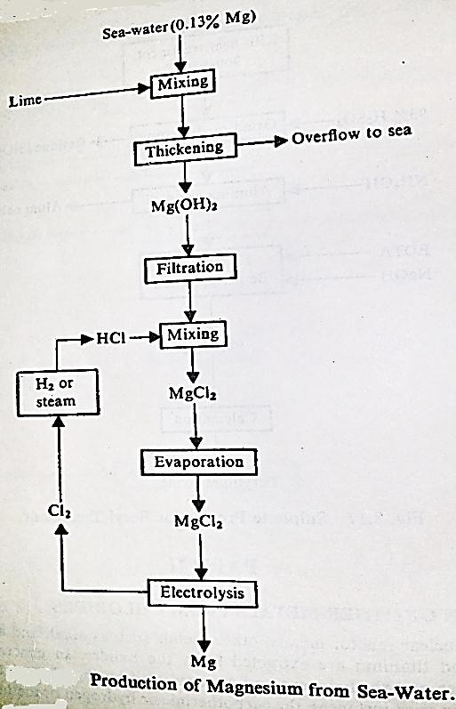
Ex.Lec 4 Extraction of Magnesium from ore oxide
Dr. Ahmed Ameed
Fe₂O₃ + 4SiO₂ + 11C 2(Fe)Si₂ + 11CO
3. Silicothermic Reduction of MgO by Ferrosilicon, at ~1400ºC under Vacuum for 8- 10 hrs. Highly Endothermic Reaction, the ratio of feed are 6 calcine dolomite: 1 ferrosilicon as briquettes.
2MgO + 2CaO + (Fe)Si 2Mg(g) + Ca₂SiO₄(s) + Fe
II. Dow Process (Electrolysis)
The Dow Process is generally applied for extraction of Magnesium from Sea water. In this process first we add lime for thickening then mix with 10% HCl.
The electrolytic cell consists of a brick-lined vessel, divided into anode and cathode compartments by a semi-wall. Air- or water- cooled Graphite plate anode and steel cathode are submerged in electrolyte composed of

Slide 3
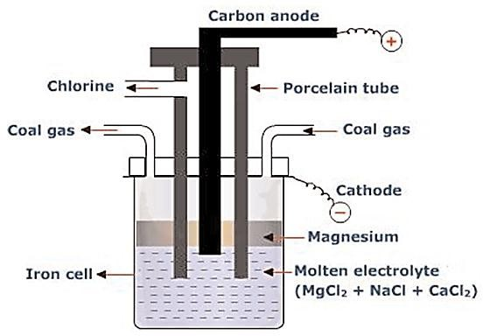
Ex.Lec 4 Extraction of Magnesium from ore oxide Dr. Ahmed Ameed
alkaline chlorides with addition of magnesium chloride. The operating temperature is 680°C to 750°C. Magnesium chloride decomposes in the electrolytic cell according to the reaction:
MgCl₂→ Mg + Cl₂ (g)
Metallic magnesium is formed at the cathode. It floats up (it is lighter than electrolyte) collecting in the cathode compartment. Chlorine, which is by-product of the process, is collected in the anode compartment.
In this method CaCl₂ and NaCl are added to anhydrous MgCl₂ to decrease its melting point.
Dow Cell

